Slide 1
Innovaccer assignment for data Science Intern
Topic-
A)Build a model to predict scores of any new reviewer, where features of reviewers and hotels are
Given.
B)Identify the most relevant features in the model
Submitted by-
Sourav Jaiswal
IIT(BHU) Varanasi

Slide 2
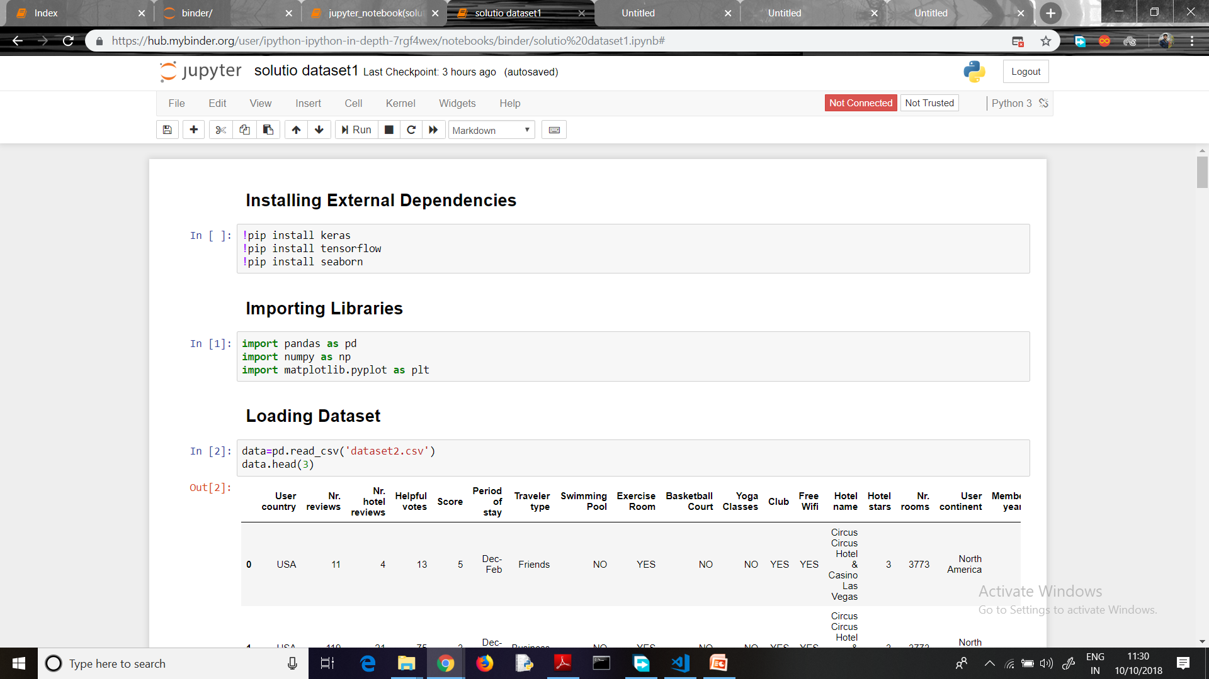
Importing libraries and external dependencies
Libraries used were pandas ,numpy and matplotlib for basic functioning,
And dependencies were keras, tensorflow and seaborn
Import dataset and augment the dataset
Dataset is imported through pandas and then we did some augmentation to make
the dataset ready for training.

Slide 3
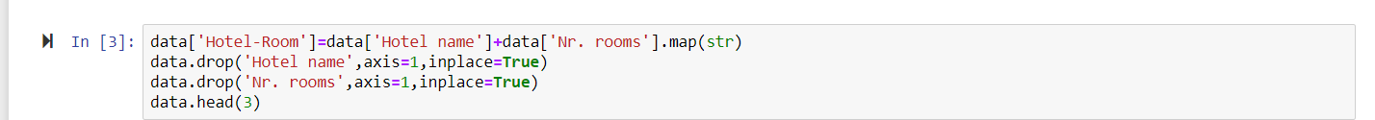
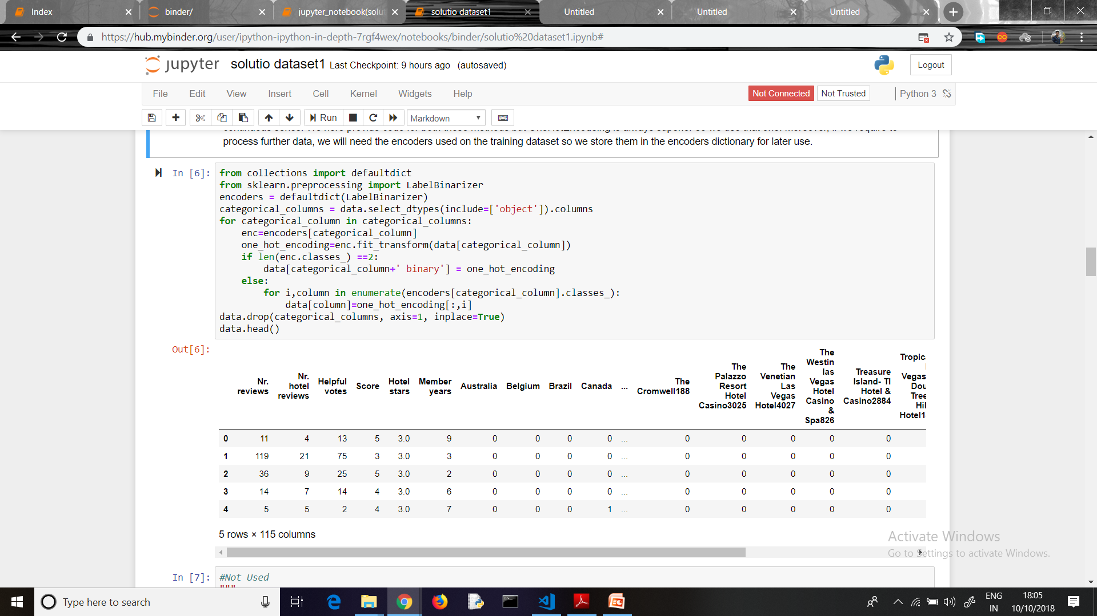
AUGMENTATIONS:-
a)Combining the hotel name and hotel room features as hotel name and hotel room are not independent, as Room 1 of hotel A is not same as Room 1 of hotel B.
b)Removing irrelevant data – The column ‘member years’ has an outlier having negative value. So we remove that row completely to rectify our dataset.
c) One hot Encoding the Categorical Classes For categorical quantities it is essential to one hot encode them (LabelBinarization). We cannot simply label encode them as they do not form an intrinsically continuous series.

Slide 4
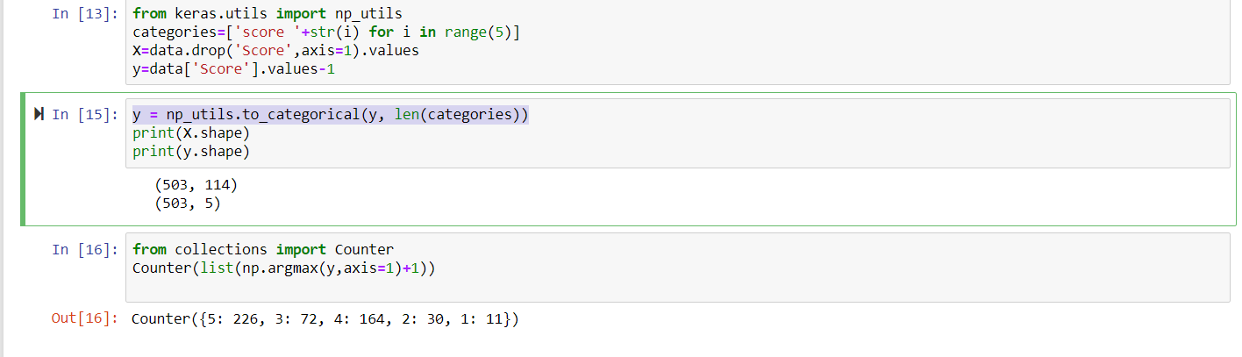
Append ‘Score’ column to the end:-
We append the Score column to the end of the dataset as it is the data to be predicted.
Converting multiclass data to categorical format:-
As we know in keras we require the data to be in categorical format so we use
“y = np_utils.to_categorical(y, len(categories))”
We use counter to see the reviews of the reviewers and we find that 226 people out of 503 have given a score of 5,which is quite large.

Slide 5
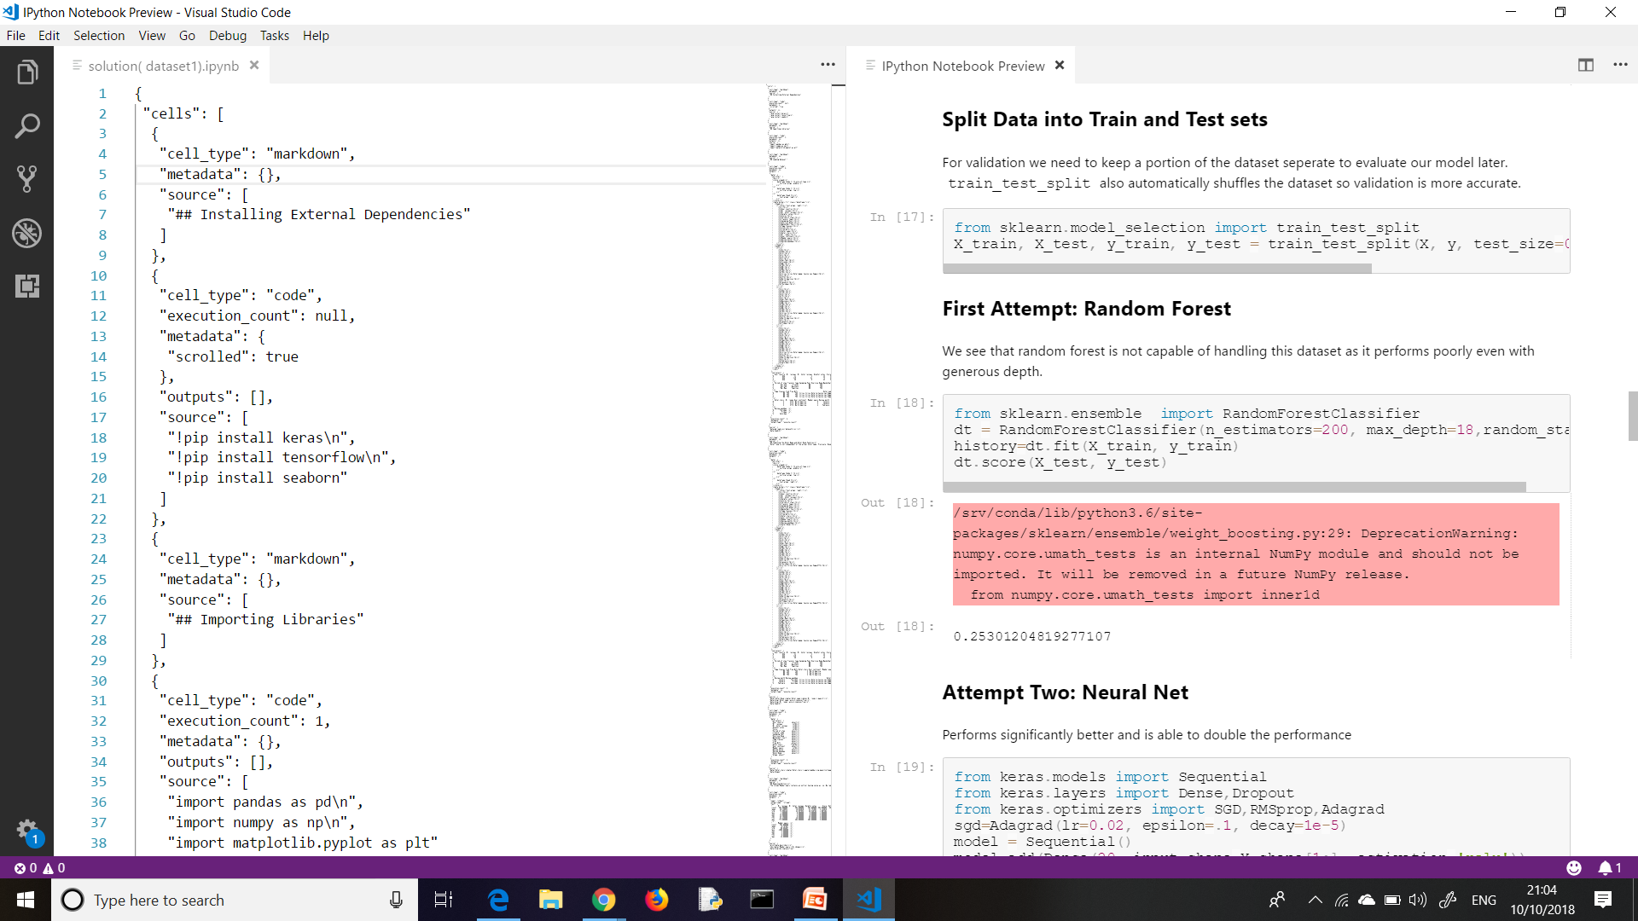
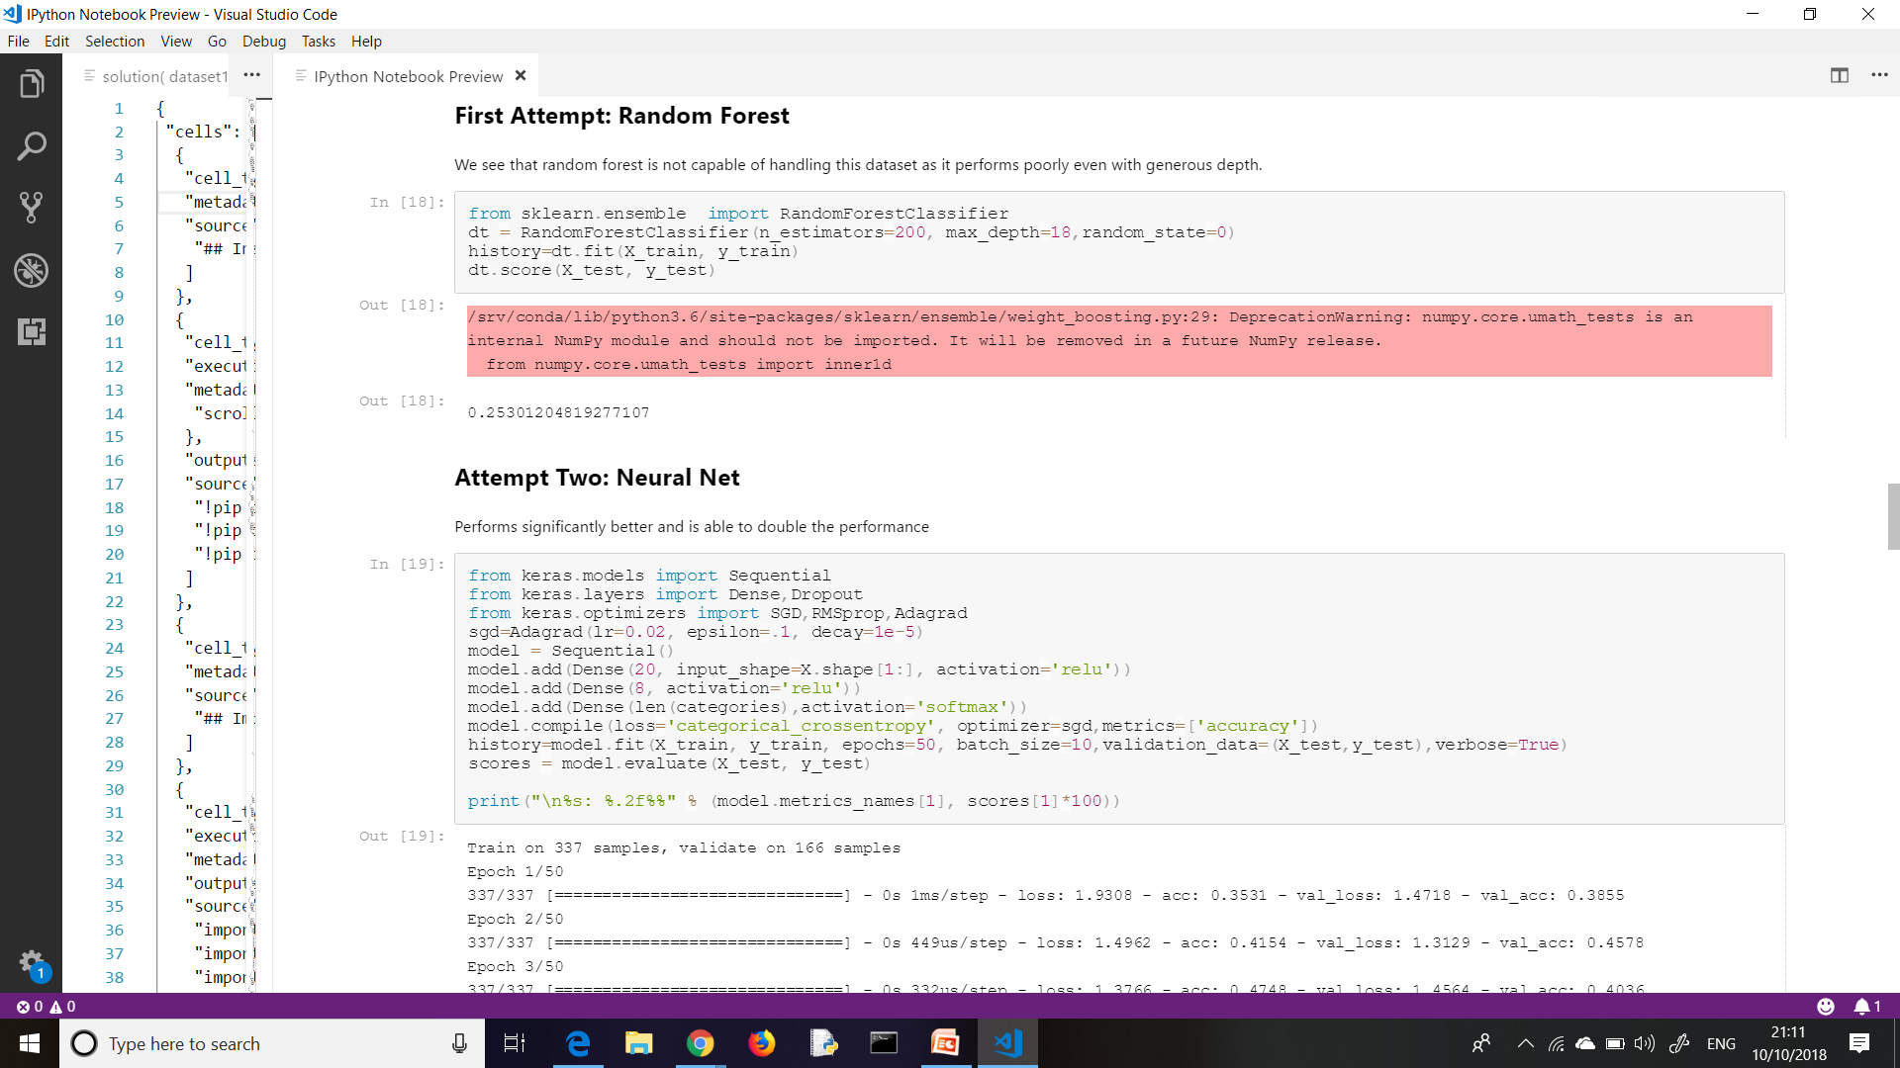
Train the model
Split data into Train and Test sets:-
For validation we need to keep a portion of dataset to evaluate our model later.”train_test_split” automatically reshuffles the dataset.
Attempt with Random Forest learning method:-
When we used random forest as a learning method we found the accuracy to be 25% which is very poor

Slide 6
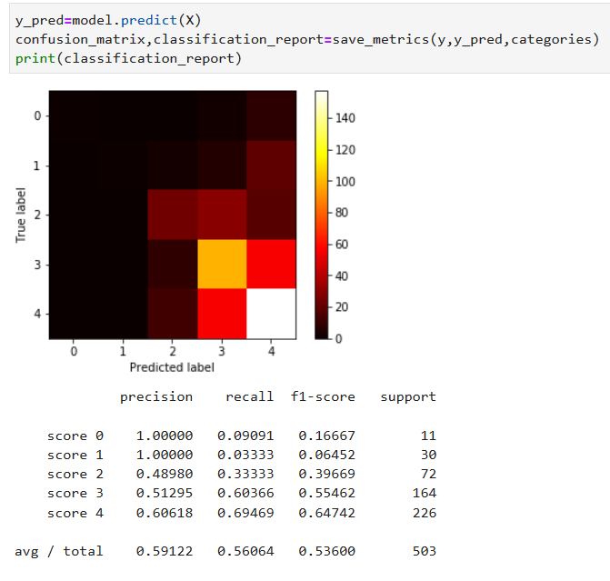
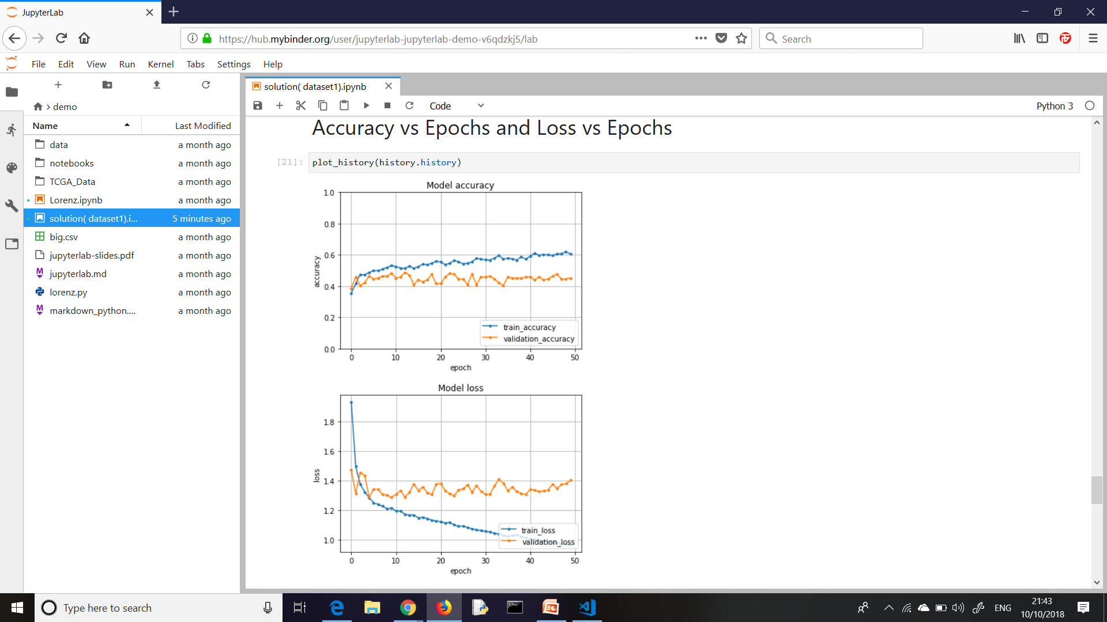
Attempt with Neural Network
Neural Net performs much better than random forest as its accuracy is much high.
In the neural network we have used “Stochastic Gradient Descent", model is Sequential and activation is softmax.
Confusion Matrix

Slide 7
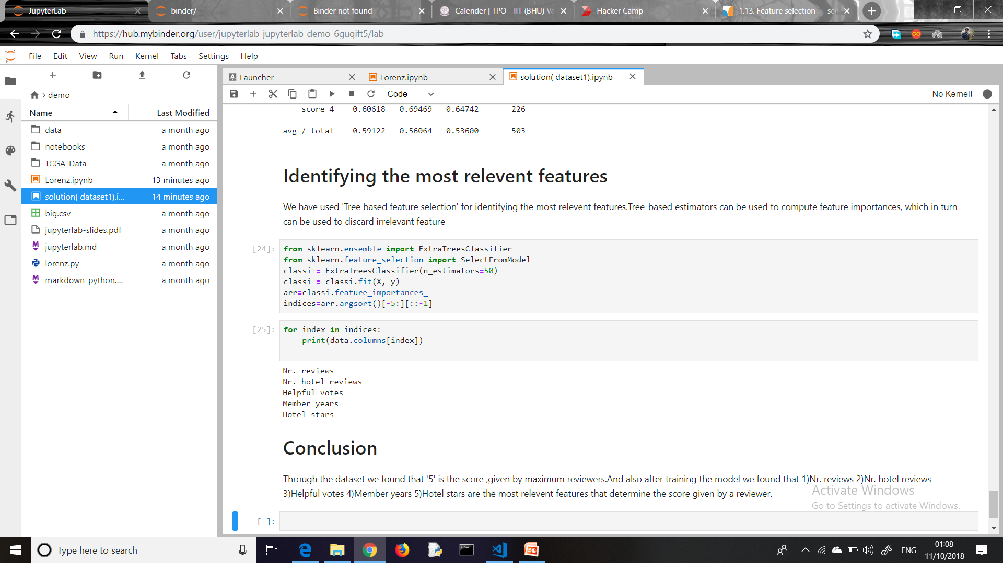
Identifying the most relevant features
Tree based feature selection:- Tree based eliminators can be used to
compute feature importance and is helpful to discard the irrelevant features ,
Hence it is very good way to find the most relevant features.
Sorting the 5 most dependent variables
Hence, We find that “Nr. Reviews”, “Nr. Hotel reviews”, “Helpful votes”, “Member years” and “hotel stars” are the most relevant features which decides the score given by a reviewer.

